Slide 1
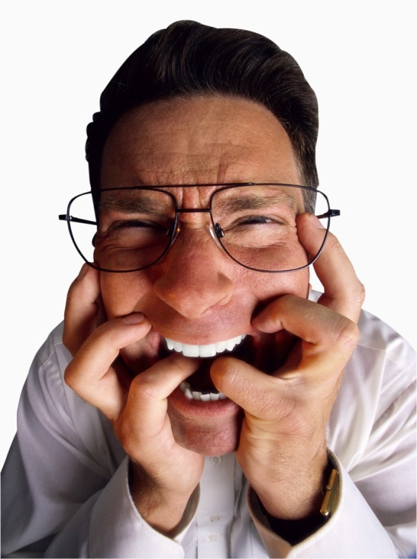
PERFORMANCE APPRAISAL

Slide 2
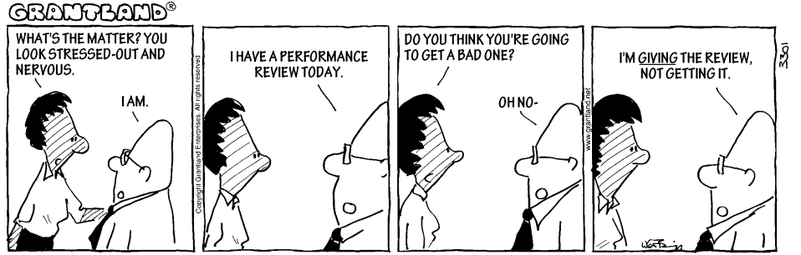

Slide 3
Honesty
  Employees being honest with themselves
  Supervisors having the courage to be honest with their employees
Communication between supervisors and employees

Slide 4
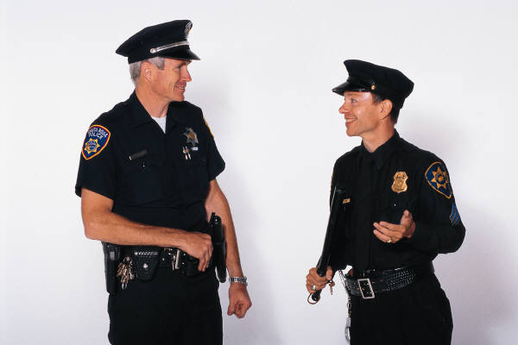
Keep the channels of communication open.

Slide 5
Coach and Mentor
Focus on building strengths rather than correcting weaknesses

Slide 6
No Surprises at Evaluation Time

Slide 7
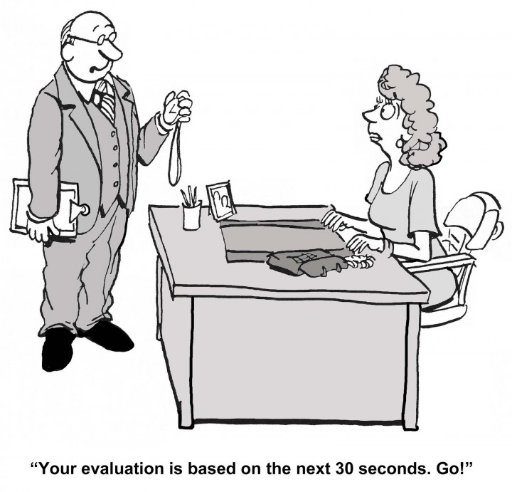

Slide 8
Performance Appraisal Process
Self Assessment
Prepare the Written Review
Conduct the Performance Review
Finalize the Written Review

Slide 9
Rating Categories
Outstanding (4): Employee is exceptional in all areas of responsibility. Performance significantly exceeds standards and expectations and can be considered a model for the department. Performance at this level is rare and would generally be recognized by peers, immediate supervisor, management, and others. This individual suggests and initiates improvements/changes and through his/her own performance has materially enhanced effectiveness of the department or work area. Performance is generally not equaled by others. For employee evaluations to retain credibility, supervisors should use this rating sparingly.
Very Good (3): Employee exceeds most position requirements. Performance at this level consistently exceeds standards and expectations and would generally be recognized by peers and immediate supervisor. Performance is characterized by notable skill, initiative and superior job knowledge. This individual’s performance exceeds most other employees in the same or similar position.

Slide 10
Rating Categories
Good (2): Employee consistently meets performance standards. The individual performing at this level is considered a fully competent, stable and skilled performer by co-workers and immediate supervisor. Employee may occasionally exceed job performance standards and expectations. This level of performance is what would generally be expected from most competent, experienced employees.
Fair (1): Employee meets some performance standards but is deficient in others. Performance does not consistently meet acceptable levels in all areas. Overall performance only meets the minimum standards and expectations. The need for further development and/or improvement is clearly recognized and expected. Performance at this level may cause the department and/or co-workers some problems or inconveniences, or tends to diminish the department’s effectiveness and/or productivity. Performance at this level is characterized as “just getting by”. Employees with an overall performance rating of Fair will be put on notice that the next 1 year performance appraisal must show an overall improvement to Good. No improvement will be grounds for disciplinary action that may lead to termination. Coaching and/or additional training by the supervisor are required.

Slide 11
Rating Categories
Unsatisfactory (0): Employee’s performance is consistently unacceptable. It is inadequate and below minimum acceptable standards and expectations. There is considerable room for improvement. Performance is causing problems/inconveniences/hardships for the department and/or co-workers and is having a negative impact on departmental effectiveness and/or productivity. This level of performance cannot be condoned or allowed to continue. A continued overall performance rating of Unsatisfactory at the time of the next Interim Performance Review will be grounds for disciplinary action that may lead to termination.
Not Applicable (N/A): Employee does not have an opportunity to use this skill.

Slide 12
Overall Rating of Employee’s Performance
Outstanding 80% of performance factors rated 4 with none below 2
Very Good 80% of performance factors rated 3 or better with none below 2
Good 80% of performance factors rated 2 or better with none below 1
Fair 80% of performance factors rated 1 or better
Unsatisfactory 80% of performance factors rated 0

Slide 13
Local 153 Overall Performance Rating Factors
Performance consistently beyond requirements
Performance beyond requirements
Competent performer
Performance below requirements
Performance greatly limited

Slide 14
On the HR Website
Employee Performance Evaluation and Development Plan for Professional/Administrative Employees
Employee Performance Evaluation and Development Plan for Not-In-Unit Nonexempt Employees
Local 153 Self Evaluation
Local 153 Performance Evaluation by Supervisors
Employee Performance Evaluation and Development Plan Instructions for Supervisors
Employee Performance Evaluation and Development Plan Instructions for Employees

Slide 15
On the HR Website
Interim Performance Evaluation Instructions for Supervisors
Interim Performance Evaluation for Professional/Administrative Employees
Interim Performance Evaluation for Not-In-Unit Nonexempt Employees

Slide 16
5 Characteristics of well designed goals
Specific
What do you want to accomplish?
Who is involved?
Where – Identify a location.
When – Establish a time frame.
Which – Identify requirements and constraints.
Why - Specific reasons, purpose or benefits of
accomplishing the goal.

Slide 17
Measurable
Establish criteria for measuring progress toward the attainment of the goal. Set milestones to indicate progress. Plan each step wisely and establish a time frame that allows the employee to carry out those steps.

Slide 18
Attainable
Should be realistic and attainable by average employees. May require employees to stretch a bit to achieve them, but should not be extreme.

Slide 19
Relevant
Should be related to helping your department/university reach its mission.

Slide 20
Time-bound
Goals should be grounded within a time frame starting point, ending point, and fixed duration.

Slide 21
Interim Performance Evaluation
Must be done for employees with an Overall Performance Rating of Fair (1) or Unsatisfactory (0).
Continued Unsatisfactory performance – review should be reviewed with your supervisor & HR prior to meeting the employee.
Overall rating of Fair – Next 1 year performance appraisal must show an overall improvement to Good (2).
Not just for poor performers. Use it as a tool for coaching & mentoring, or to track progress on goals. It’s a good opportunity for Communication.

Slide 22
What Motivates Employees?
Top 10 MOTIVATORS | Rank from 1 – 10
Good wages
Job Security
Promotion and growth
Good working conditions
Interesting work
Personal loyalty to employees
Tactful disciplining
Full appreciation of work done
Help with personal problems
Feeling of being “in” on things

Slide 23
What Motivates Employees?
Responses from Survey of Employees
Top 10 MOTIVATORS | Rank from 1 – 10
1. Good wages | 5
2. Job Security | 4
3. Promotion and growth | 6
4. Good working conditions | 7
5. Interesting work | 1
6. Personal loyalty to employees | 8
7. Tactful disciplining | 9
8. Full appreciation of work done | 2
9. Help with personal problems | 10
10. Feeling of being “in” on things | 3

Slide 24
Top 10 Job Expectations
Type of work: the kind of work that makes the best use of one’s abilities and gives one a feeling of accomplishment.
Security: having a job that provides a steady employment.
Company: working for a company that has a good reputation, that one can be proud of working for.
Advancement: being able to progress in one’s job or career, having the chance to advance in the company.
Coworkers: having coworkers who are competent and congenial.
Pay: being paid at least enough to meet one’s needs, and being paid fairly in comparison to others.
Supervision: having an immediate supervisor who is competent, considerate, and fair.
Hours: having working hours that allow one enough time with family and/or time to pursue other strong interests and live one’s preferred lifestyle.
Benefits: having benefits that meet one’s needs and compare well with those of others.
Working Conditions: having physical working conditions that ae safe, not injurious to health, not stressful, and even comfortable.
(Survey published by Career Key 3/16)

Slide 25
Interesting Statistics from WorldatWork
65% of employees do not believe performance ratings accurately and objectively reflect their performance.
58% of employees say that the use of ratings creates a negative experience for everyone except the few at the top.
92% of leaders and 89% of employees believe traditional rankings and ratings should have some role in determining rewards in the future.

Slide 26
Discipline Process

Slide 27
This process applies to all non-faculty employees.
Except in a case of gross misconduct* where immediate dismissal is deemed to be the appropriate course of action, the Disciplinary Process must be followed before termination may take place.

Slide 28
*Gross Misconduct includes but is not limited to fighting, threats of bodily harm, possessing a dangerous weapon, alcohol, or illegal substance on university premises, theft, falsifying time and other records.
* immediate dismissal or suspension pending investigation may be the appropriate course of action
In cases of gross misconduct, the AVP of Human Resources must be contacted.

Slide 29
Prior to terminating an employee for poor performance, coaching/counseling is a required course of action.
The University’s Progressive Disciplinary Process must be followed in its entirety as described below.

Slide 30
Reminder- Local 153 Union Members must be given the option to have a campus union representative present at all coaching/counseling meetings.

Slide 31
First Step
Supervisor meets with employee to clearly define the problem.
Gives clear information on the steps the employee must take to correct the problem and meet the standards set by the supervisor.
Offers the employee any reasonable help that will correct the problem.
Schedule a second meeting date at a time that gives the employee a reasonable time to correct the problem.
Complete Employee Guidance Record, OR send an email following up on the discussion, outlining where improvement is warranted and steps discussed to achieve improvement.
Note: If the Employee Guidance Record is used, request that the employee sign. If the employee refuses to sign, make a note on the bottom of the form and provide the employee and the Associate Vice President of Human Resources with a copy.

Slide 32
http://hr.fdu.edu/documents/guidancerecord.pdf

Slide 33
Second Step
If by the time the second meeting takes place the problem has been corrected, complete the Employee Guidance Record OR send an email indicating that the negative performance has improved.

Slide 34
If the problem continues to exist, contact the Associate VP of Human Resources to inform and discuss scheduling the 2nd disciplinary meeting.
Proceed to complete the Employee Guidance Record OR a summary of the continued concerns in advance of the meeting. The document must indicate that the employee will be subjected to disciplinary action up to and including termination if the problem has not been corrected by the time of your third and final meeting.
Schedule the third and final meeting, allowing a reasonable amount of time for the employee to correct the problem.

Slide 35
Third Step
If by the time the third meeting takes place the problem has been corrected, complete the Employee Guidance Record OR send an email indicating that the negative performance has improved.
If the problem has not been corrected, please contact the Associate Vice President of Human Resources in advance of the third meeting to discuss the lack of improvement.
The AVP of Human Resources will discuss if disciplinary action or termination is warranted.
The third meeting will include the AVP of Human Resources or designee to discuss the discipline/termination decision.

Slide 36
Tips for conducting a successful disciplinary meeting
Do not delay
Avoid chitchat at the start of a meeting – acknowledge immediately this is going to be a difficult meeting
Provide examples – talking in genialities provides little guidance to remedy the issues
Avoid focusing on intent (“You’re not trying”) – it cannot be proved and it may appear as an attack – when attacked employees fight back
Stay away from “why?” - don’t speculate – instead you can say: “we want you to succeed is there anything we can do to help?” This could lead to a potential discrimination claim

Slide 37
Tips for conducting a successful disciplinary meeting (Continued)
Make no excuses – don’t take responsibility unless you are responsible
Watch for code words – Some comments may be construed as discrimination such as “you are too emotional”
Avoid absolutes – do not say “you always” or “you never” – it’s better to say “almost always”
Listen – you must give the employee an opportunity to talk. It important to hear what an employee says as what they do not say.
Be aware of eye contact and body language (face the employee with good posture and eye contact and be engaged – do not be distracted by other work)
Be aware of the tone of your voice – don’t sound apologetic (might diminish the sense of seriousness). Are you calm? Are you firm?

Slide 38
Mock disciplinary Meeting
Background
Pat is a long term employee at a large fitness center.
Pat is a member of a protected class.
Pat is the assistant to the Jo, the General Manager.
Pat’s responsibilities include fielding calls and in-person inquires when Jo is out of the office or in meetings, scheduling maintenance for equipment, posting the weekly information of mandatory meetings to the staff, and assisting with other projects as needed.

Slide 39
Mock Disciplinary Meeting – Issues in the workplace
For the past several months Pat has been consistently late to work. Pat started being 5 minutes or so tardy to work at first. However, Pat’s tardiness is now exceeding 30 minutes almost every work day.
Other employees have relayed to Jo Pat is often inappropriate with the members. Pat is alleged to having yelled at members for requesting such items as additional towels in the locker rooms.
Pat has also been seen giving some members special treatment and providing them with free items from the juice bar and acting flirtatious (along with patting members as they walk by).
The fitness center has recently had problems with the pool company used for weekly maintenance of the indoor Olympic sized pool. Jo asked Pat to research other pool companies and provide a comparison spreadsheet to understand types of services and costs of each of the local pool companies. Pat missed the deadline and the current pool company was a no show for their weekly maintenance. Jo had to quickly step in and find a pool company to service the pool without having to disrupt the members by closing the pool while awaiting service.

Slide 40
Inappropriate Dialogue
Jo: Hi Pat, how was your weekend? It was such perfect weather. Is your Mom feeling better after having the flu last week?
Pat: She’s feeling better but I had to help her with all her food shopping, driving her to the pharmacy, and helping her around the house. It has been a tough week. I really did not get to enjoy the nice weather this weekend.
Jo: (do not make eye contact - turn body away): I’m sorry to have to talk with you but the real reason I asked you to come in is because of your recent performance. It just has not been adequate and you need to do a better job. (Start to look at computer screen)
Pat: That’s not true. The members love me and I do my work.
Jo (yell as if you were scolding your child): You’re always late and projects are never done on time.
Pat: That’s not true. I have only been late this past week because of my mom and I was late with the pool company information because–
Jo: (interrupt me by starting the next line)
Jo: No, Pat – you were late consistently for past several months and the pool company project is just one request that was not completed. You missed sending out last week’s meeting reminder. Stop being rude to the customers when they ask for towels and do not give out free items from the juice bar or flirt with the members. We will meet again in 1 week.

Slide 41
Appropriate Dialogue
Jo (Make good eye contact and posture): Pat, I asked that you meet with me today to discuss recent performance issues. We will be discussing your tardiness with attendance and missing project deadlines as well. We will also be discussing customer service issues.
Pat: What do you mean? I have only been late a few times and Taylor is late a lot. I only missed one email reminder to the staff about the weekly meeting.
Jo: We are not here to talk about others’ behavior. We are here to talk about you and what needs to change. You recently also missed the deadline to research the pool companies
Pat (looks down becoming sad): I’m sorry. Work has been so difficult for me. I have been having trouble with my eyes. My doctor says a magnifying screen will help but I am too afraid to ask. I am afraid I may lose my job.
Jo: I will discuss this with Human Resources and we will have a follow up meeting. We also need to discuss customer service. I have noticed and have been told you are yelling at members. Also, you must arrive to work on time. This is not acceptable behavior. Do you want to be successful?
Pat: Yes, this is a wonderful place to work and I understand. I have been so frustrated about the difficulties on the computer. I will work on my communication and my timeliness to work
Jo: We will have a follow –up discussion in 1 week. I will discuss the magnifying screen with Human Resources. Please greet the members in a friendly manner and speak to me about computer projects that may be difficult. If you need to speak with me before then, please let me know.

