Slide 1
Core Common State Standards and “College Readiness”
August 22, 2013
Vicki L. Cohen
Director, School of Education
Fairleigh Dickinson University

Slide 2
Core Common Standards (CCSS)
The Common Core State Standards Initiative (CCSSI) is a state-led effort coordinated by the National Governors Association (NGA) and the Council of Chief State School Officers (CCSSO) started in 2009.
www.corestandards.org

Slide 3
What are the CCSS?
New K-12 grade standards in English/Language Arts (ELA) and Mathematics
Much more specific than the NJ CCCS
Raise the bar: higher standards
ELA: more difficult texts, more informational texts, higher order thinking, integrated into Social Studies and Science
Math: algebra at a lower level; less topics and more depth

Slide 4
New Assessments
2 different groups developing the assessments
PARCC for New Jersey
Goal to be used for college placement into credit-bearing classes
Collaboration with higher education

Slide 5
Why Common Core State Standards?
College- and career-ready: succeed in education and training after high school;
Internationally benchmarked;
Equity: not dependent on a student’s zip code;
Focused, coherent, and clear;
Collaboration: across states, K-12 and higher education

Slide 6
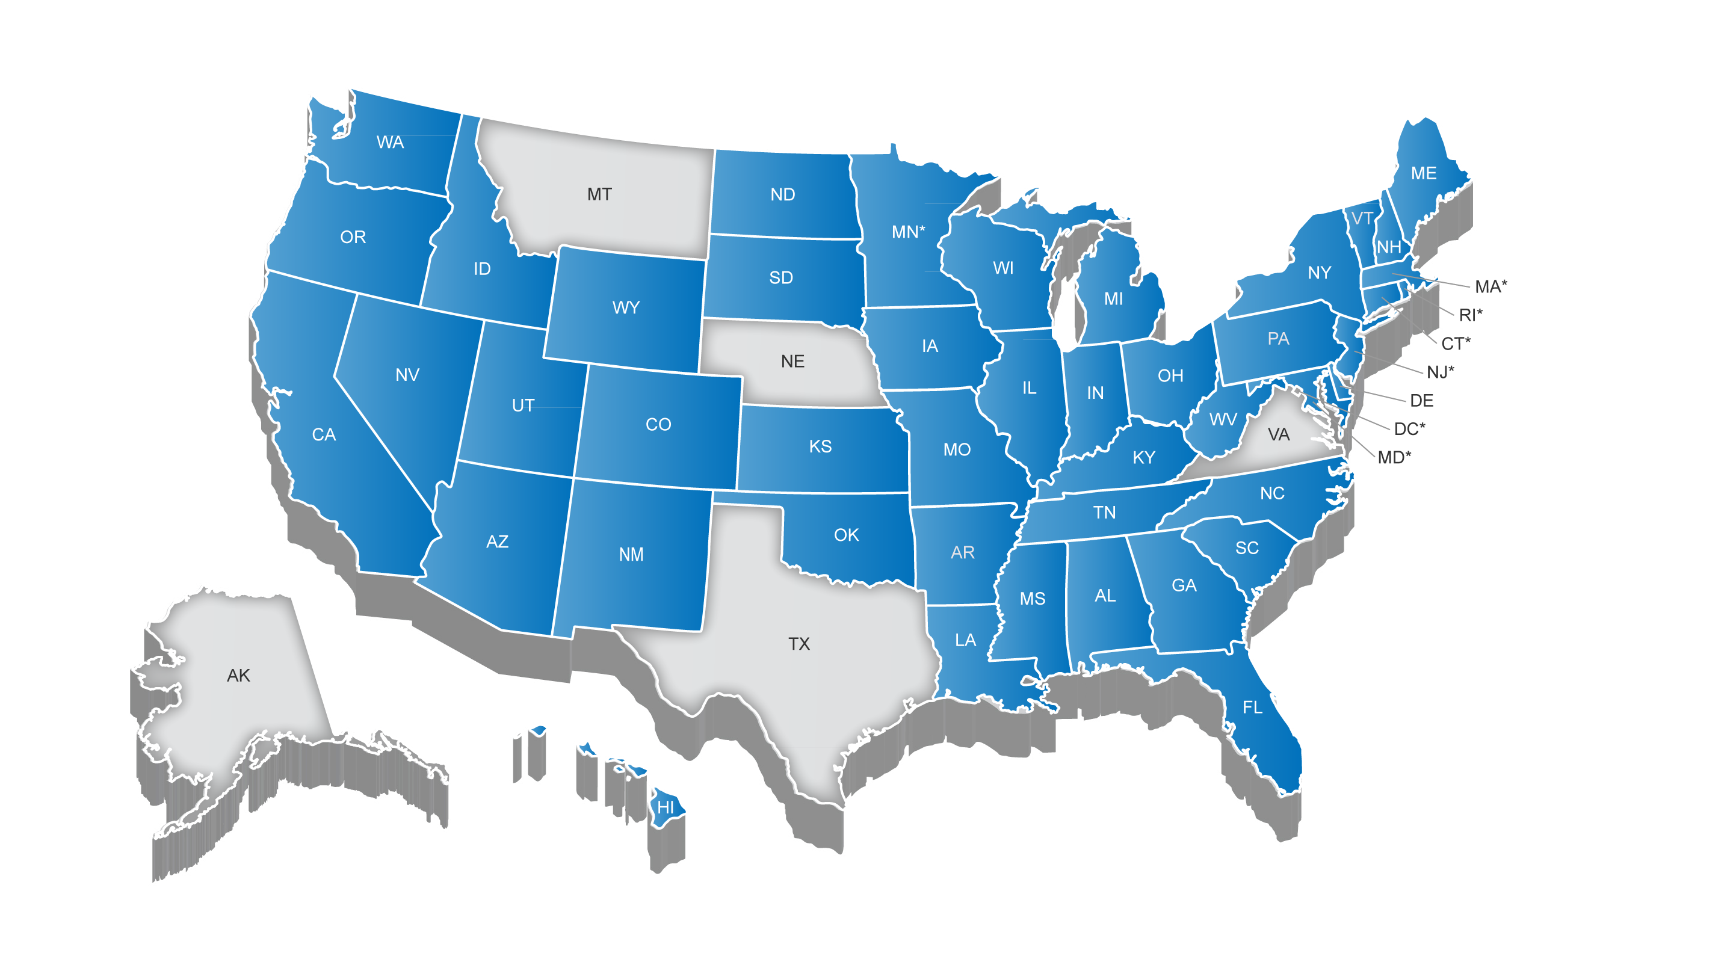
45 States + DC Have Adopted the Common Core State Standards
* Minnesota adopted the CCSS in ELA only

Slide 7
Why are The CCSS Important?
For many young people, high school wasn’t preparing them for college or careers
States had different standards
Prepares students with knowledge and skills to succeed in college and career
Ensures consistent expectations regardless of a student’s zip code
Provides educators, parents and students with clear, focused guideposts

Slide 8
New Jersey High School Proficiency Assessment Language Arts Literacy Proficient or Above by Ethnicity (2002-2008)
.

Slide 9
New Jersey Grade Eight Students: Science Percent Proficient or Above by Ethnicity (2000-2008)

Slide 10
New Jersey High School Proficiency Assessment: Mathematics Proficient or Above by Ethnicity (2002-2008)

Slide 11
High School PISA 2003 Math Of 29 OECD Countries, U.S. Ranked 24th
U.S.A.
Source: Organization for Economic Cooperation and Development (OECD), PISA 2003 Results, http://www.oecd.org/

Slide 12
High School PISA 2003 Problem-Solving U.S. Ranked 24th Out of 29
U.S.A.
Source: Organization for Economic Cooperation and Development (OECD), PISA 2003 Results, http://www.oecd.org/

Slide 13
Many College Students Fail to Earn a Degree in New Jersey
Percent of students earning a bachelor’s degree within six years in New Jersey, 2007

Slide 14
Enrollment in College Does NOT Equal College Readiness
Percentage of U.S. first-year students in two-year and four-year institutions requiring remediation

Slide 15
Of Every 100 9th Graders in New Jersey…

Slide 16
New Jersey Public College and University Remediation Rates
Institution | % Needing Remediation
Kean | 70%
Montclair | 54%
New Jersey City University | 62%
NJIT | 40%**
Ramapo | 23%
Rowan | 21%
Rutgers | 33%
Stockton | 14%
The College of New Jersey | 8%
William Paterson | 72%
Total | 40%
Among first time students Fall 2004
**Estimate

Slide 17
Community College Remediation Rates
Community College | % Needing Remediation
Atlantic Cape | 77.6%
Bergen | 81.8%
Brookdale | 79.8%
Burlington | 73.8%
Camden | 81.0%
Cumberland | 80%
Essex | 91.4%
Gloucester | 73.2%
Hudson | 67.9%
Mercer | 83%
Middlesex | 78.5%
Morris | 76%
Ocean | 67.7%
Passaic | 96.3%
Raritan Valley | 78%
Salem | 92.5%
Sussex | 75%
Union | 67%
Warren | 75%
Total | 77.8%
First-time, full-time students who graduated from high school in Spring 2004 and enrolled at a community college in Fall 2004.

Slide 18
Personal Benefits of Education in New Jersey
New Jersey Statistics: Total Unemployment: 11%, Mean Income: $55,535

Slide 19
Employer’s Satisfaction Levels
By Educational Attainment | % Excellent or Good | % Fair | % Poor
Private Colleges & Universities | 84.5 | 13.4 | 2.1
State Colleges & Universities | 76.1 | 21.2 | 2.7
Community/County Colleges | 59.2 | 35.9 | 4.9
Private High Schools | 70.5 | 26.4 | 3.1
Private Training Institutes | 60.7 | 34.4 | 4.8
Public Vo-Tech Schools | 49.7 | 42.9 | 7.4
Public High Schools | 32.9 | 52.3 | 14.8

Slide 20
When I was growing up, my parents used to say to me, … “finish your dinner – people in China and India are starving. My advice to you today is…finish your homework – people in China and India are starving for your jobs.”
Thomas Friedman
The World Is Flat
2005

Slide 21
Why FDU?
Small classes
Available resources to help students
Accessible faculty and staff
Access to professional training
Top-quality faculty
Caring environment

Slide 22
Developing A CCSS Task Force
Every college and university in NJ urged to set up a CCSS Task Force
Focus on transition from high school to college
Use the CCSS as placement into credit-bearing courses?
Math and English departments must be involved
Contact me if interested: cohen@fdu.edu

