Slide 1
Termination Notification Manual

Slide 2
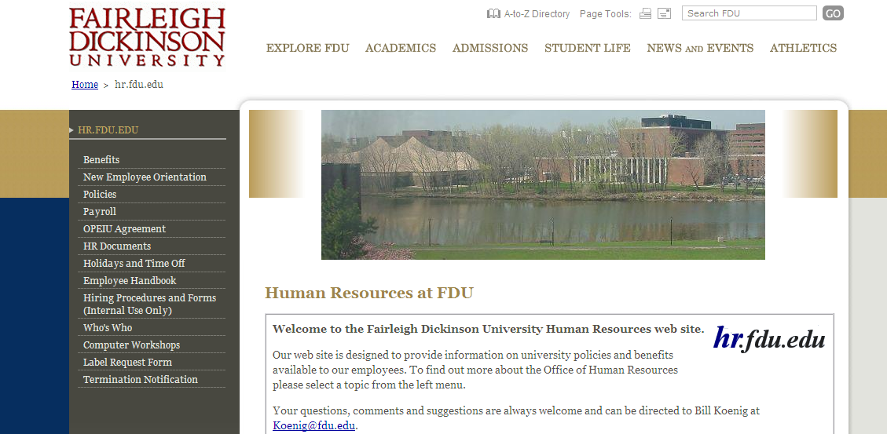
Click on our Termination Notification Link located on the side of the HR.FDU.EDU home page

Slide 3
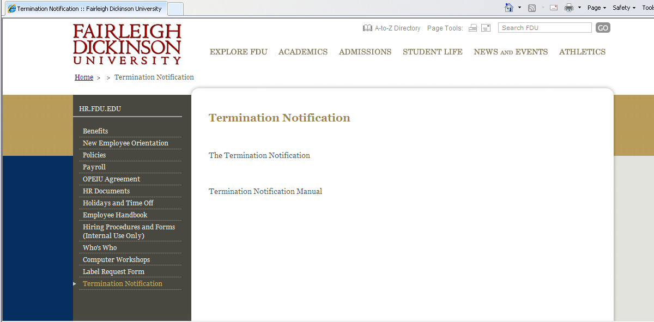
Click on our The Termination Notification Link to begin your process.

Slide 4
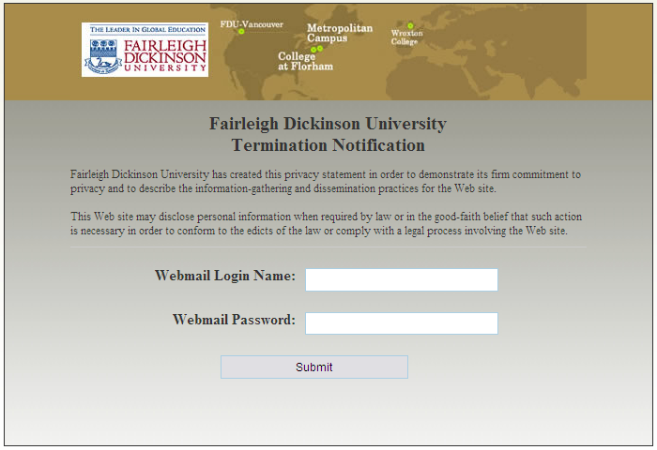
Home Page of the Termination Notification site. Use your Webmail login and password to access and begin using this site. In the event you have forgotten your login and password please contact UTAC at 973.443.8822

Slide 5
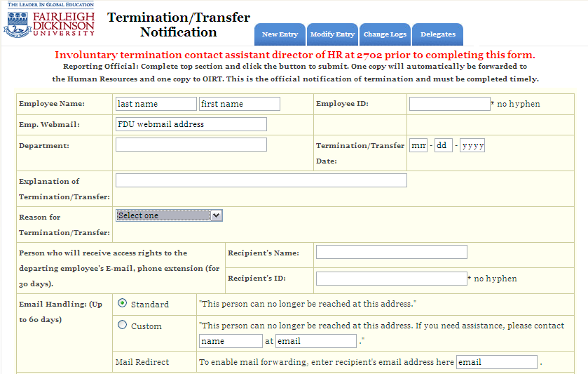
Fill in all fields on this page & select boxes that pertain to confiscated University property in the Supervisor Checklist, click Department Supervisor Submit to finalize your Termination & to send this Notification to HR & ORIT Departments.

Slide 6
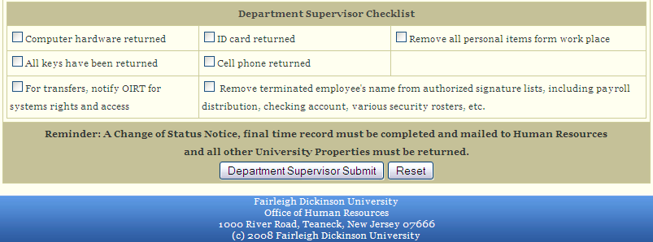
To modify an existing entry, click on the Modify Entry tab located on the top of the page . This tab allows Supervisors to see only what they have entered and to make updates on previously sent Terminations.

Slide 7
The Delegates tab allows a supervisor to assign or remove employees privileges within your department access to create a Termination Notification. If any assistance is needed throughout this process please contact Bill Koenig at either koenig@fdu.edu or 201.692.2735.

