Slide 1
The Water Infrastructure of
FDU Metro
Nana Addo & Ayaa Yousef

Slide 2
Our Statement
How to reduce the FDU Metropolitan Campus’ negative impact on the Hackensack River ecosystem.
The protection and maintenance of this river is infrastructurally important because it has a direct effect on local ecosystems and larger bodies of water. The waste we produce such as garbage and other pollutants easily end up in the river causing great harm.

Slide 3
Our Plan
Since most stormwater runoff is not managed on FDU’s campus, to gain full advantage of the freshwater received from storms, by following NYC’s approach of facilitating and harvesting runoff from storm water by placing rain gardens to help with stormwater runoff drains. Rain gardens on campus would be designed to collect and manage stormwater that runs off the Hackensack River.

Slide 4
With the use of a number of plants and specialized soil, the rain gardens will actually filter out chemical pollutants. By implementing these rain gardens on campus, the water in the river will not mix with trash, fertilizers from the greenery, or salt in the parking lot during wintertime.
In addition to this main objective, small things can also be done to ensure the river remains sustainable. For example, as a student body it is imperative that we keep the campus clean by properly recycling or throwing out waste before it gets close to the river. It would also beneficial to limit the amount of chemicals used on our landscape.

Slide 5
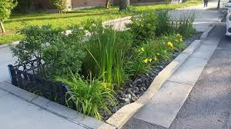
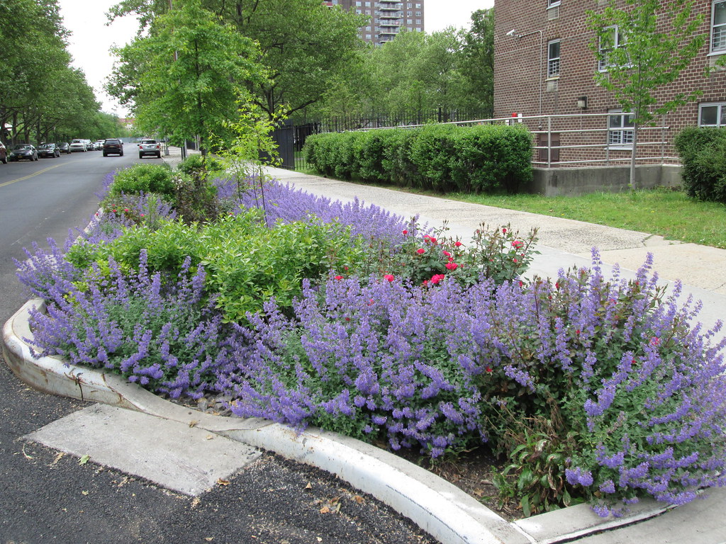
Images of the Rain Gardens that would be placed.
Pictured is the rain gardens in NYC, showing the groove in which the storm water will be guided to.

Slide 6
Other Colleges
University of Pennsylvania along with most of Philadelphia has experienced combined sewage overflow (CSO), which impacted one of their local rivers. Entitled the Stormwater Master Plan, UPenn decided to institute a Green Stormwater infrastructure. In order to reduce the amount of CSO and stormwater runoff they have created green roofs, porous pavement, and vegetated bioretention areas.

Slide 7
California Polytechnic State University who received the STARS Gold Rating this year intends to improve their water quality. The school has established three principles: effectively prohibit non-stormwater discharges through the storm drain system, implement controls to reduce the discharge of pollutants to receiving waters, and follow provisions that the Regional Water Board has determined. What also makes this college stand out is that they prioritize education of students and public involvement.

