Slide 1
Housing & Residence Life
LIVE, LEARN, & GROW – THE FDU WAY!​

Slide 2
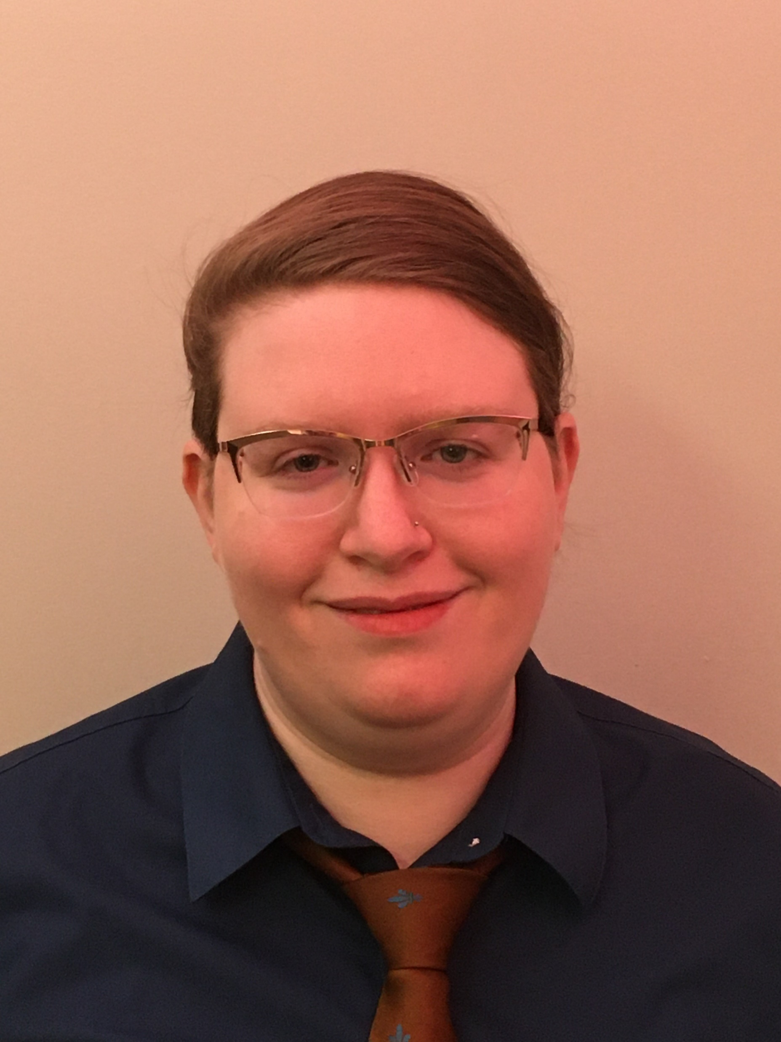
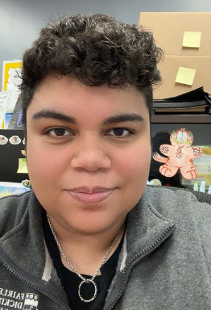
Meet The Team
University Director
Associate Director
Assistant Director of Marketing
Housing Coordinator
Administrative Assistant

Slide 3
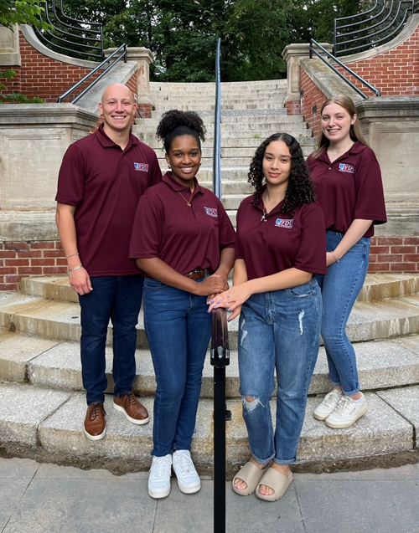
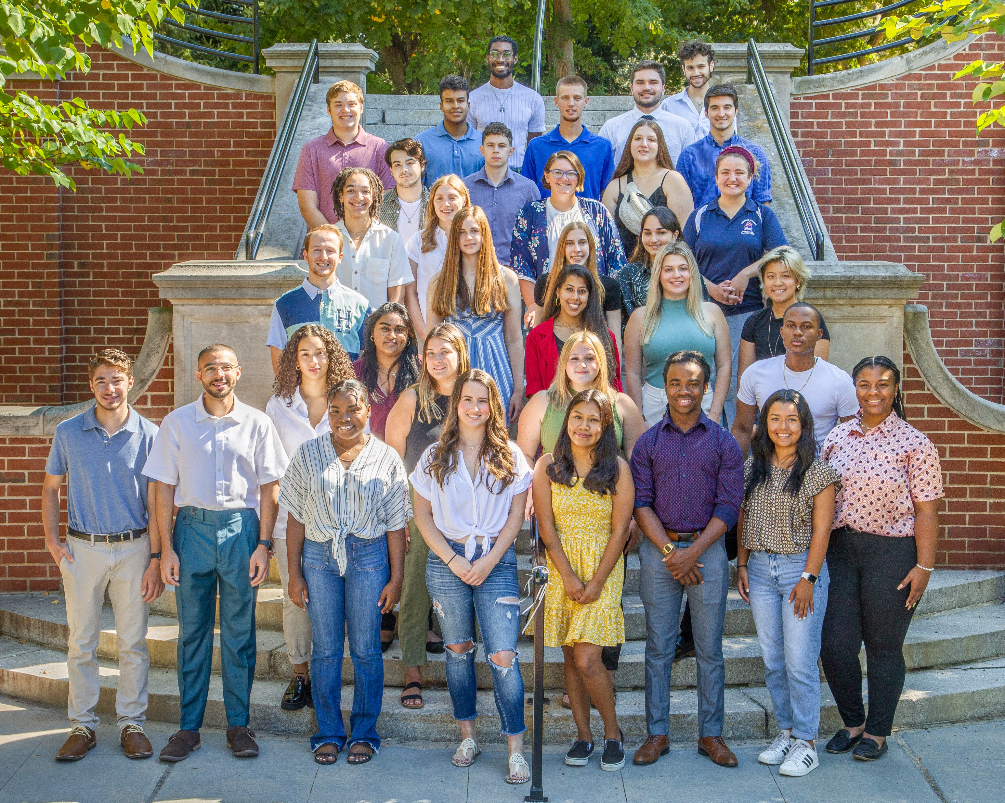
Meet The Team (Cont.)
Graduate Hall Directors
Resident Assistants

Slide 4
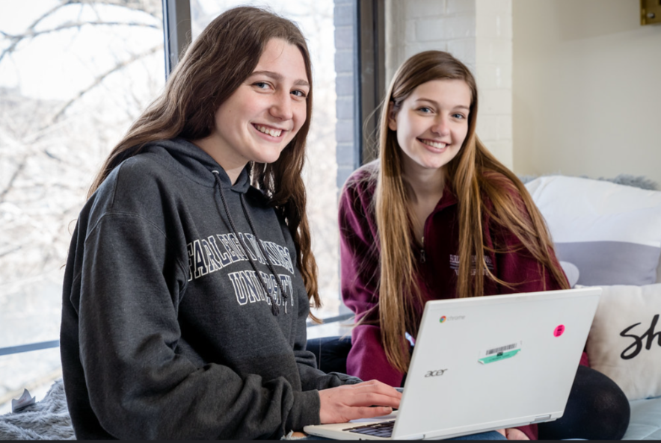
Housing and Residence Life
Applying for Housing ​
Room & Board Assignments​
Requesting A Roommate​
Room & Meal Plan Changes​
Health & Safety Inspections​
Furniture, blinds, and shades replenishment. ​
Honor’s Housing​
Guest & Visitation Policy​
Resident Manual​

Slide 5
Housing and Residence Life (Cont.)
Free laundry available to all residents​
Streeme IPTV streaming
Live TV
Recording up to 20 hours of programming
Mailroom Services
Located in:
Lower level of the Mansion
M-F: 9 am – 5 pm
Microfridge Rentals
https://www.mymicrofridge.com/ ​
Mail student packages with
the following format:
Student Name
Fairleigh Dickinson University
285 Madison Ave, Madison, NJ 07940

Slide 6
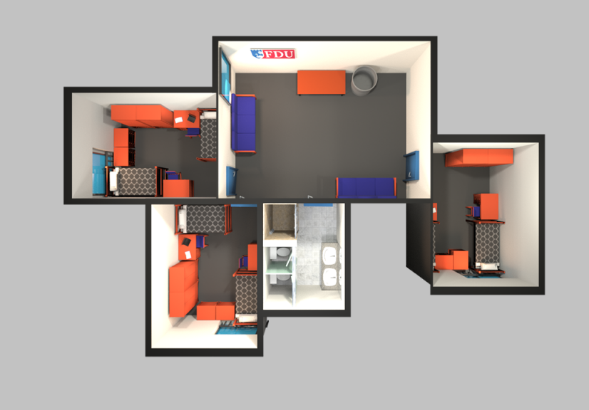
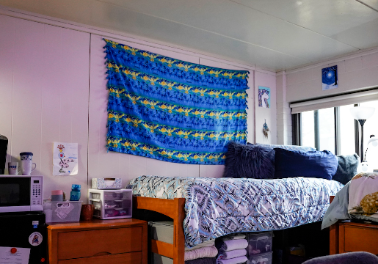
Village
9 buildings – suite style living
1, 2, 4, 5, 6, and 9 are fully Freshmen
Each building consists of:
3-4 rooms per suite
Shared suite bathroom
Kitchen in buildings 3, 8, 9
Gender Inclusive options
Coed by building and floor
Note: no overhead lighting, bring lamps!

Slide 7
Frequently Asked Questions
How do I select a roommate? You may either pair with a roommate through the MyHousing portal, or email fduhousing@fdu.edu with your request.
Can I pick suitemates? Yes! Follow the same process as for roommates. You may select up to 5 suitemates.
Do I have to have a meal plan? Yes, all first-year students are assigned Meal Plan A (unlimited dining hall swipes)
What if I'm in Honors? You will be housed in Danforth (Building 9) in the Honors community, unless you request otherwise.
Is there athletic housing? Not officially, but many athletes choose to live in suites with other athletes. Contact your coach if you're looking for a roommate!
Can I bring a car to campus? Yes, but there is a parking fee for Freshmen. Parking is in the Park lot.
If I don’t live on campus first-semester, can I move on later? Yes! Many students commute for their first semester or year and then join campus housing.

Slide 8
ITEMS STUDENTS CAN BRING
ITEMS STUDENTS CANNOT BRING
Additional Lighting (Non Halogen Desk/Floor Lamp) Recommended for Village Rooms
Adhesive Hooks and Strips (that do not damage the wall; for example Command Strips)
Area Rug
Bath Tote/Bucket/Shower Caddy
Bedding (Mattress Pad, Foam Topper)
Blender
Can Opener
Digital TV/Blue-Ray/DVD/Cable Wire
First Aid Supplies
Ironing Board/Iron
Keurig (without a Hot Plate)
Medication/Pain Relievers
Microwave (No more than 800 Watts)
Mini Garbage Can
Video Game Consoles
Surge protected Power Strips
Refrigerator (4.5 Cubic Feet Max)
Underbed Storage
Air Conditioners/Space Heaters
Alcohol Beverages (including Containers and Paraphernalia; for example, empty bottles and/or short glasses)
Candles or Incense
Extension Cords (non-surge protected)
Fireworks
Flammable Liquids
George Foreman Grills
Halogen Lamps
Hot Plates
Hover Boards, electric scooters/bikes
Illegal Drugs (including marijuana)
Loft Beds, bed lofters, or cinder blocks
Multi-Plug Adapters
Pets (besides fish)
Sofa/Couches
Toaster Oven/Toasters
Upholstered Furniture
Water/Gel Beds
Weapons of Any Kind (knives, guns, etc)

Slide 9
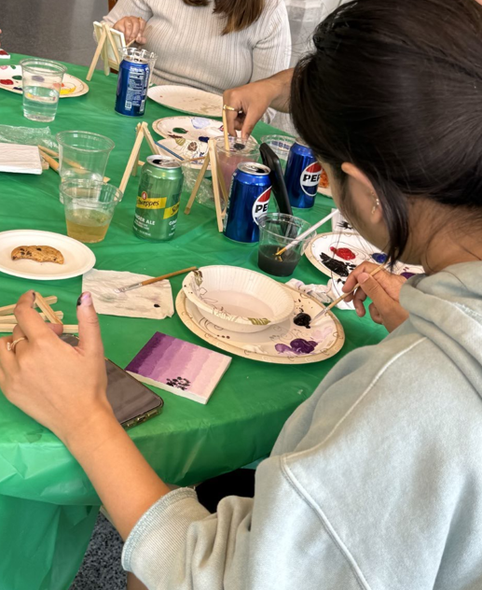
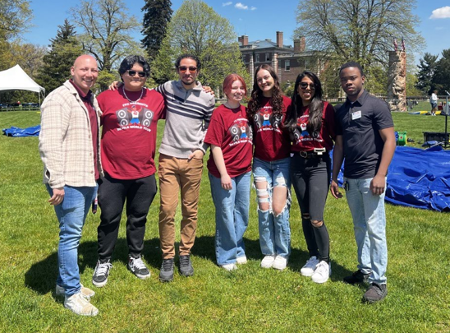
Housing and Residence Life
Staff on-call (evenings and weekends)​
Monthly Floor/Building Meetings​
Hosting over 130 social, cultural, community service and educational programs & events ​
Roommate Conflict Mediation ​

Slide 10
LIVE
SAFELY
COMFORTABLY
RESTFULLY
Close doors​
Scan ID when entering​
Register all guests (including family!)​
Ask for help from RAs and Public Safety
Clean your room​
Throw out trash​
Do your laundry​
Shower regularly​
Clean your fridge​
Turn off lights​
Turn down music​
Turn down TV​
Send guests home​

Slide 11
LEARN
Quiet Hours​
Study Space​
Roommate Agreement​
Time Management​
Activities & Programs​

Slide 12
GROW
Make Friends​
Attend Campus Events​
Build Relationships​
Learn Conflict Management​

Slide 13
QUESTIONS FOR YOU​
Laundry
Cleaning
Studying
Conflict
Goals
Do you know how to wash, dry, and put away your clothes?
Do you have a way to wipe spills and remove dust? Do you know how to keep clean?​
Do you have tools to stay on task with studying?​
Do you know how to handle conflict?
Are there skills you’d want to learn?​
What do you want to get out of this living experience?​

Slide 14
BEING AN EXCELLENT ROOMMATE TAKES PRACTICE, DESIRE, AND LUCK. DO YOUR BEST AND ASK FOR HELP!

Slide 15
Apply for Housing!
Apply For Housing:
https://www.fdu.edu/student-life/housing/process/apply/
MyHousing Portal:
www.fdu.edu/florhammyhousing
All Things Housing:
www.fdu.edu/housing
*** Spring Application Live on Nov. 1st, 2024

Slide 16
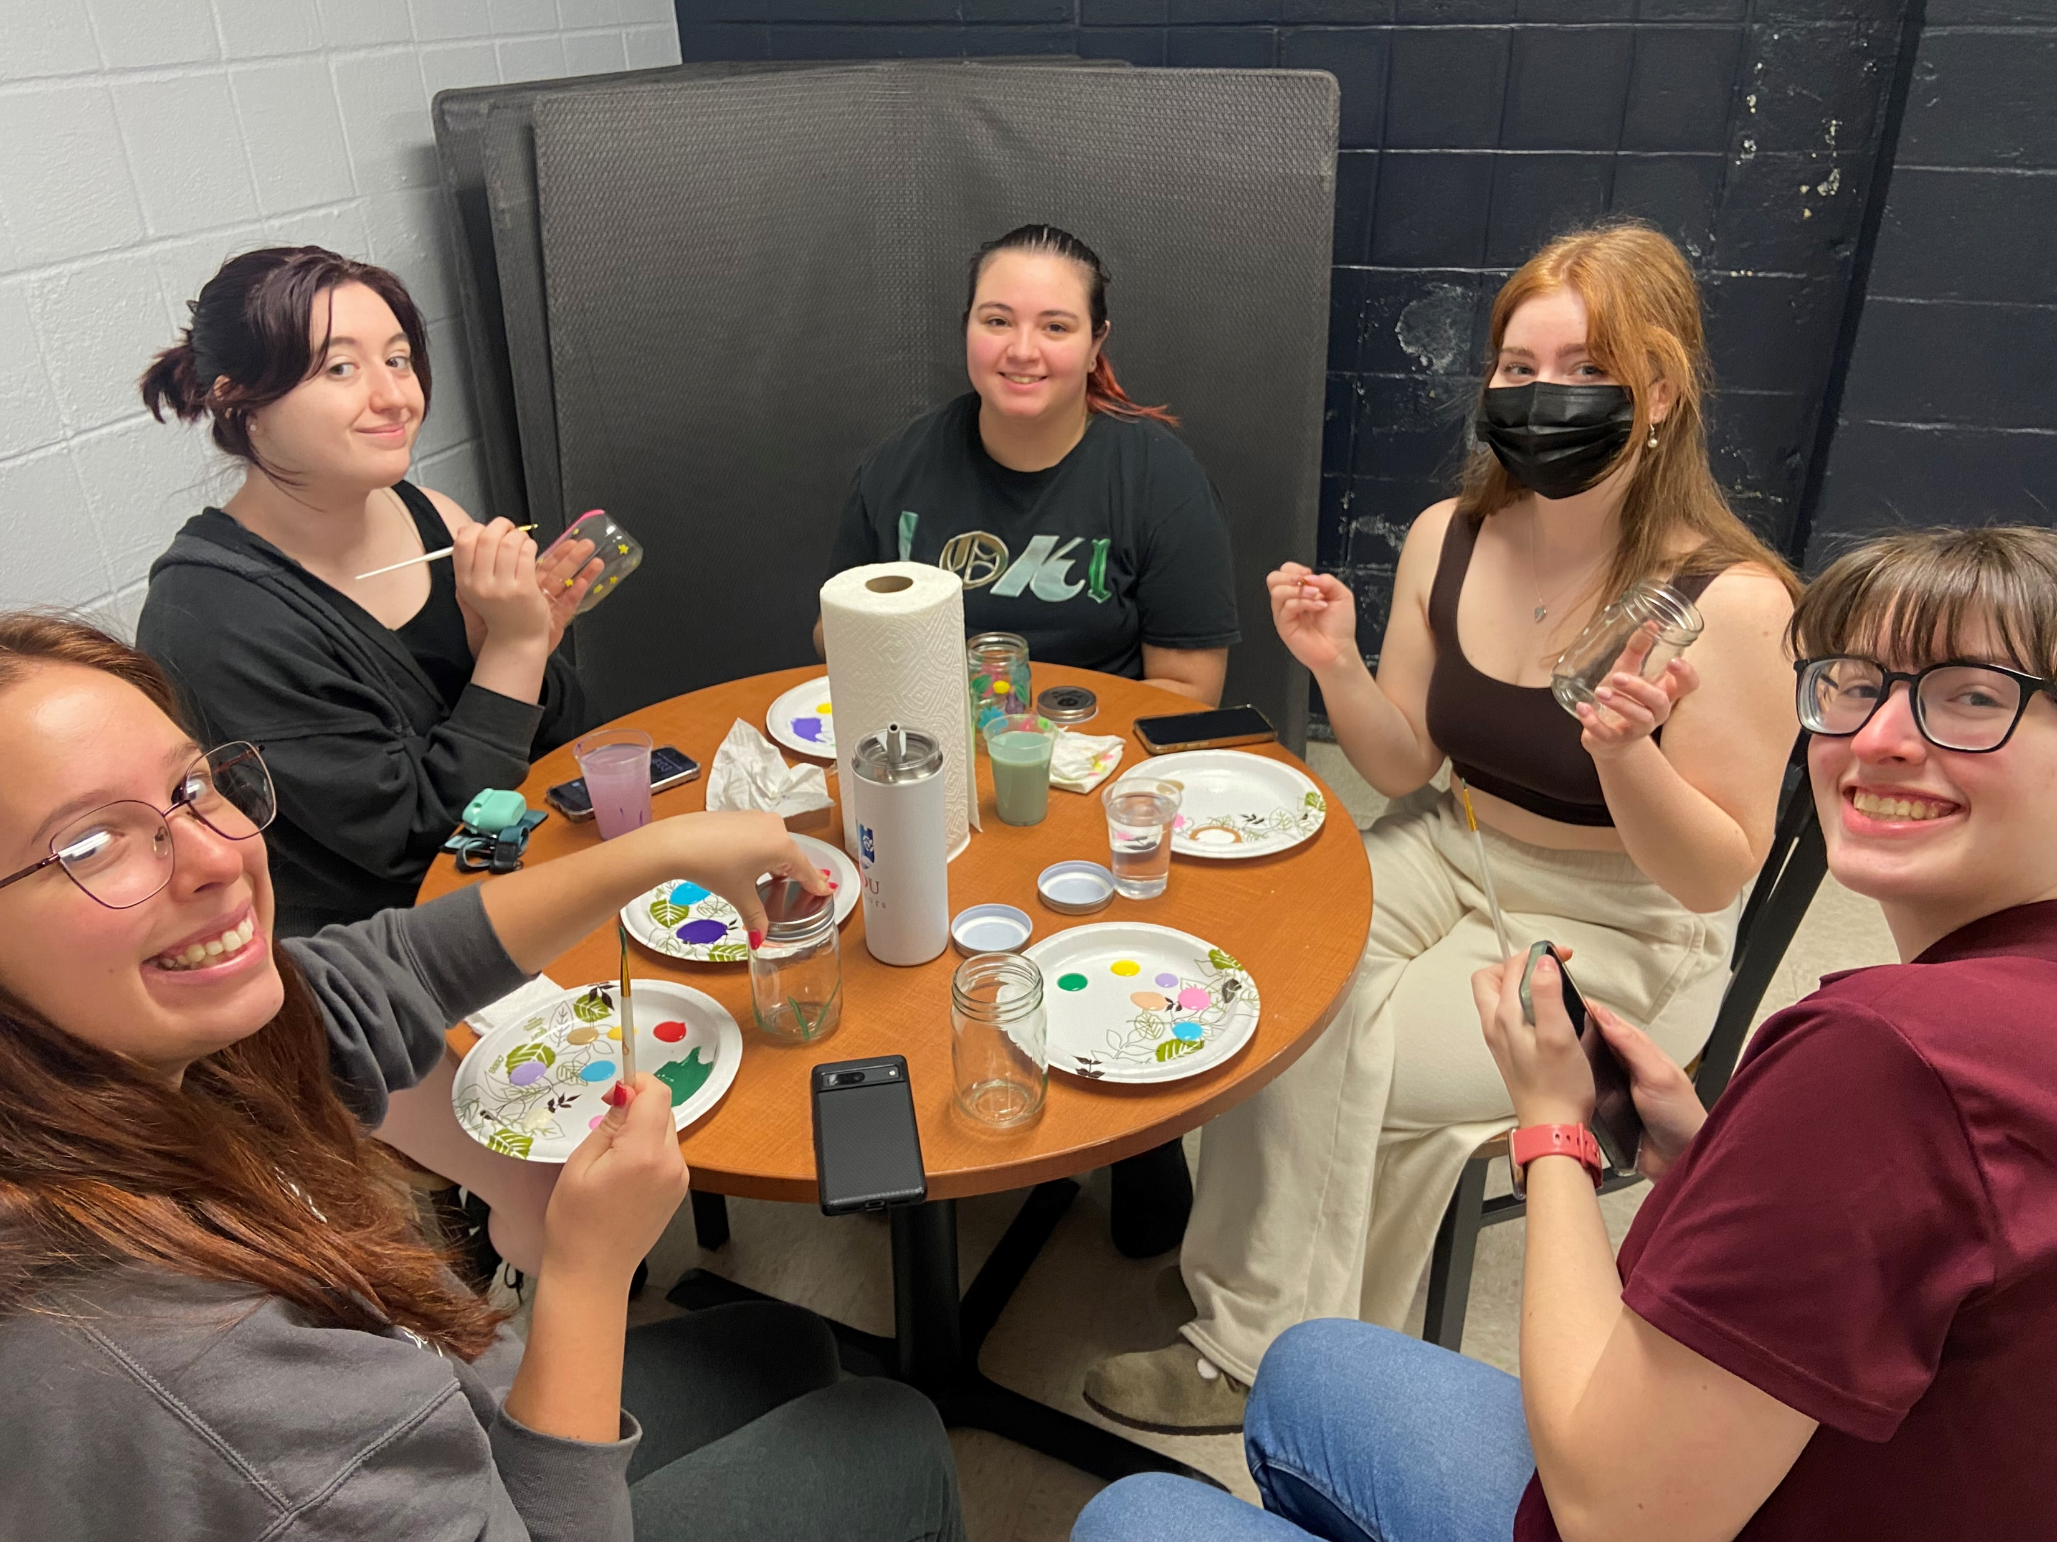
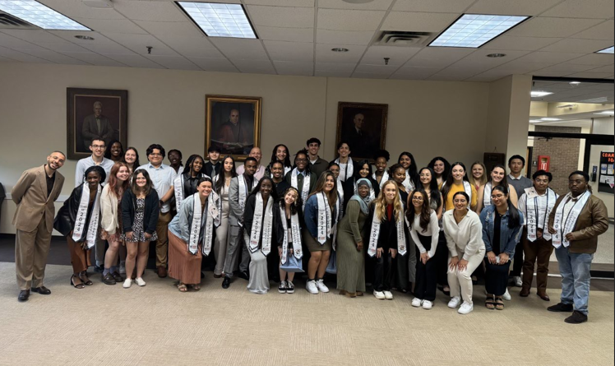
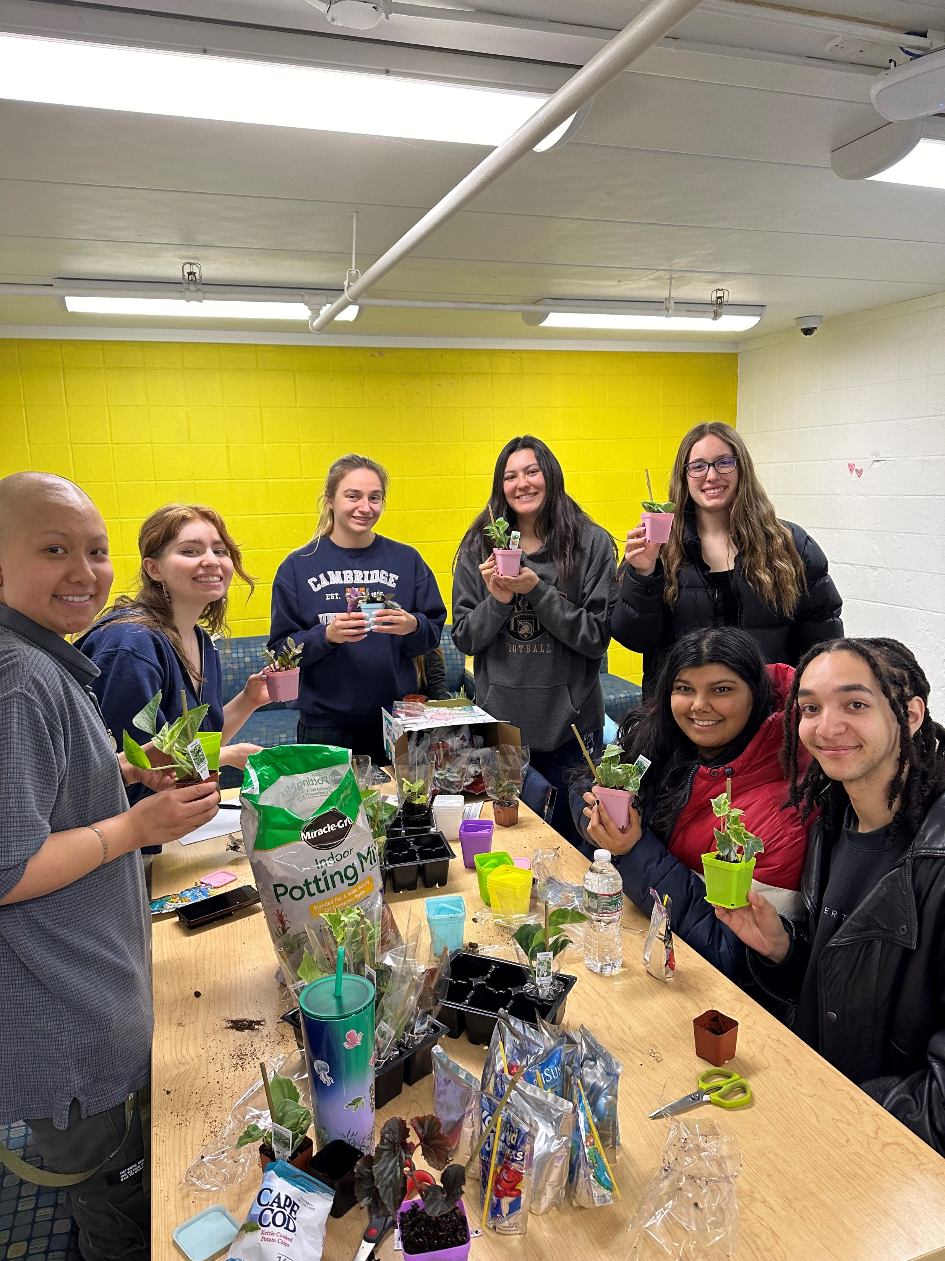
Follow us on Social Media!
@fduflorhamhousing
@fduhousing

Slide 17
Contact Housing!
973-443-8586
www. fdu.edu/housing
fduhousing@fdu.edu
@fduflorhamhousing
Office located in the Student Center

Slide 18
Thank You!
Questions?

