Slide 1
Presents...
Student Life at FDU
Welcome to our lively, engaging, and friendly community!

Slide 2
The Student Life Team
Sarah B. Azavedo
Xavier Orrala Adrian
Emily Agresta
Assistant Dean of Students
Graduate Assistant for Student Activities
Graduate Assistant of Greek Life
TBA
Juan Gonzalez
Natalie Van
Student Life Coordinator
Graduate Assistant Comptroller
Graduate Assistant for Program Collaborations

Slide 3
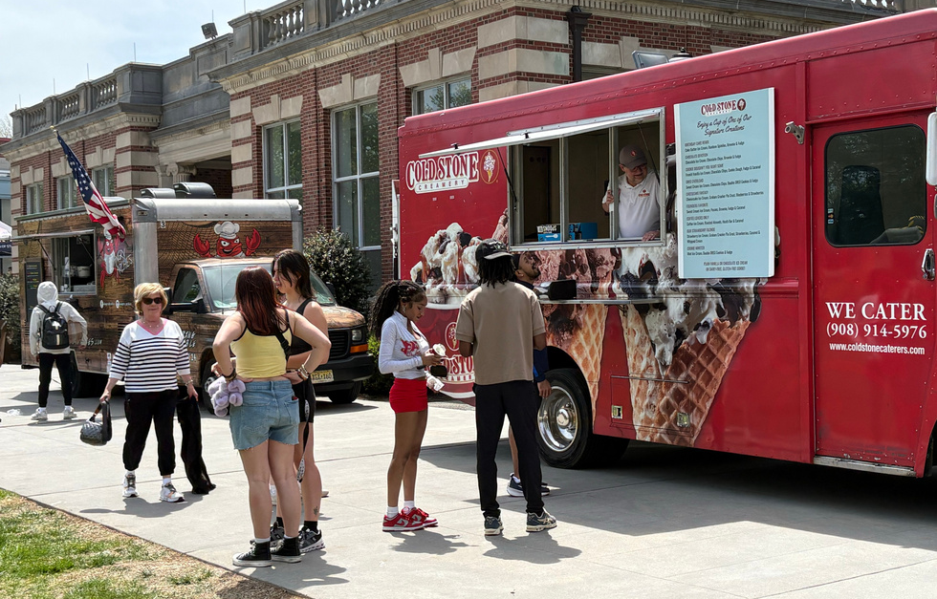
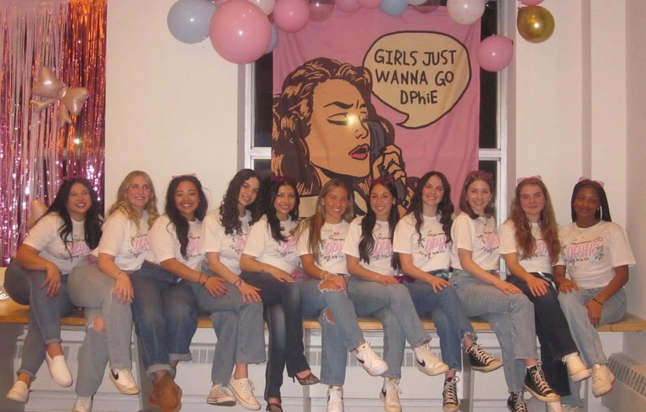
The student Life Mission
We support you in your goals for development and growth both professionally and personally.
We strengthen your leadership, communication, interpersonal, and organizational skills.
We are here to enhance your university experience.

Slide 4
A snippet of Student Life
Student Programs
Greek Life
Lots of exciting and interactive programs both smaller and larger scale
FREE on campus events and off campus trips for ALL students!
Staple Large Scale Events: Devil Days, Ian’s Luau, Wild West, Haunted Mansion, and Devils World
Lively and vibrant Greek Community on campus
Involved in lots of philanthropic initiatives and charities
Tight-knit and fun Greek Fraternities, Sororities, and Cultural Organizations for all!
With that in mind: Shout out some clubs/orgs/sports you were involved with in High School!
Raise your hand if you are interested in being involved in a club/org when you get on campus!

Slide 5
Staying up to date with events
Weekly Sunday Email
Monthly Event Calendar
Flyers and Social Media
Weekly calendar is sent to your student email on Sunday evenings!
You can also locate activities on the university website calendar!
At the end of the previous month, there will be monthly event calendars you can pick up at the student center!
Lots of clubs/orgs post their upcoming events on instagram and through flyers around campus

Slide 6
Major organizations!
Left to Right:
Florham Programming Committee (FPC)
Greek Senate
Student Government Association (SGA)
Commuter Student Association (CSA)
Student Atheletic Advisory Committee (SAAC)
Progress Pride

Slide 7
Stay Connected on socials

Slide 8
Office Info!
Office Location: First Floor of the Student Center
Office Hours: 9-5pm
NOTE:
If we do not have a club that interest you, let’s talk and create one! For further questions here contact Assistant Dean of Student Sarah B. Azavedo (azavedo@fdu.edu)
Intramurals/Sports Teams?
Contact Assistant Dean of Students Sarah B. Azavedo (azavedo@fdu.edu)

Slide 9
Important Upcoming Dates
August 26th
Interfaith Mixer &
FPC’s Wild West Party
September 3rd
Club Fair
September 27th
Homecoming + Family Day
October 29th
FPC’s Haunted Mansion
August 21st
Ian’s Luau
August 24th
Campus Comeback
August 28th
Commuter Student Breakfast
& Meet the Greeks
September 26th
Pep Rally
October 13th & 14th
Fall Recess/Break

Slide 10
FAll 2025 Club List

Slide 11
Quiz Time!
(JK, but please raise your hand to give an answer 🙂 )
1) WHAT IS THE NAME OF FDU FLORHAM’S MASCOT?
a) Nitro the Devil
b) Ian the Devil
c) Daphne the Devil
d) Oz the Devil
2) HOW MANY CLUBS ARE THERE AT FDU?
Shout out how many you think there are!
** The answer includes all clubs and greek orgs
3) WHICH OF THESE IS THE IMPOSTOR CLUB?
a) True Crime Club
b) Fairleigh Artists Association
c) FDU Filmmakers
d) DJ Devils
4) WHAT ARE YOU MOST EXCITED FOR WHEN YOU GET TO CAMPUS!?
Shout out your answer!
** Answer can be whatever you are excited about!

Slide 12
Contacts for Questions!
Sarah B. Azavedo, Assistant Dean of Students azavedo@fdu.edu
TBA, Campus Life Coordinator for Student Programming & Greek Life
Juan Gonzalez, Graduate Assistant Comptroller j.gonzalez437@student.fdu.edu
Emily Agresta, Graduate Assistant for Greeks emilyagresta@student.fdu.edu
Xavier Orrala Adrian, Graduate Assistant for Student Activities x.orralaadrian@student.fdu.edu
Natalie Van, Graduate Assistant for Program Collaborations n.van@student.fdu.edu

