Slide 1
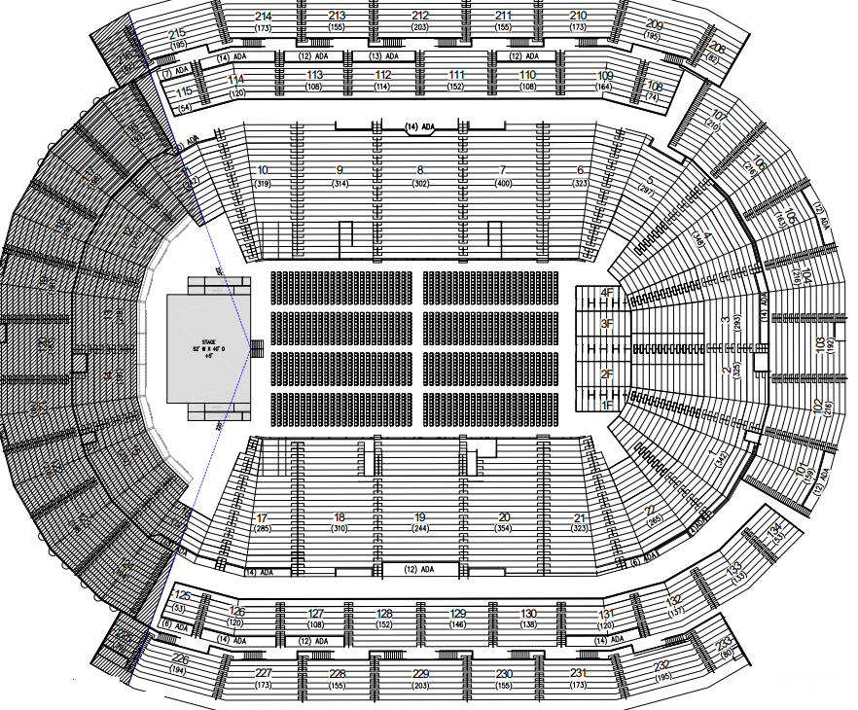
Silberman College of Business
College of Pharmacy and Health Sciences and Gregory H. Olsen College of Engineering and Science
Henry P. Becton College of Nursing and Allied Health and Marion Turpan College of Psychology and Counseling
Maxwell Becton College of Liberal Arts and Education

